Slide 1

SAP UI5 & FIORI
Srinivas
Day – 2

Slide 2

Agenda – Day 2
Introduction to CSS
Inline style CSS
Internal style CSS
Concept of Box Model in CSS
Concept of Pseudo Classes in CSS
External style CSS
What is JavaScript?
Basic usage of JavaScript
Important Points about JavaScript
Variables and Data Types
Arrays and Objects in JS
How to Apply JS to HTML Page
Inline and Internal JS
Changing CSS at runtime
Adding Dynamic Content
Debugging
Synchronous and Asynchronous Response
External JS
UI5 Json Model Introduction
UI5 Data Binding

Slide 3
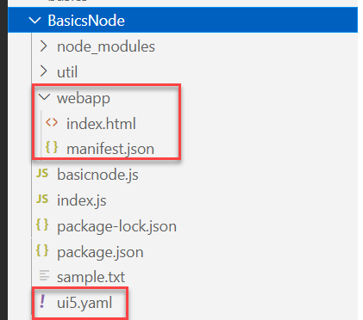
Hands – on: Starting an App using NodeJS
Now we will serve a basic html page on the local server with the help of ui5 tooling.
But before we start we have to install a few dependencies:
ui5 cli:- npm install @ui5/cli to install globally: npm install -g @ui5/cli
ux-ui5 tooling:- npm install @sap/ux-ui5-tooling to install globally: npm install –g @sap/ux-ui5-tooling
Now we have to create a webapp folder in our node project folder, and in that webapp folder create two files index.html and manifest.json.
Also create a ui5.yaml file in the project folder.
Add the required code in all the files form the links provided below.
Now to run the project use command: ui5 serve
Code Links:
index.html
manifest.json
ui5.yaml

Slide 4

Introduction to jQuery
jQuery is a java script library, which is used to simplify our JS code.
The moto is to minimize JS code size.
Why we use jQuery?
It’s free to use (Open Source)
Used by top software companies like google, Netflix, etc.
Light weight JS library
jQuery greatly simplifies JavaScript programming.
Available on internet
Purpose is to write less and do more
Industry standard
How to use?
Download the jQuery library and keep it in our project, just like we use util/mycode.js
Reference jQuery from CDN (Content Distribution/Delivery Network) – directly reference it from internet
Documentation of jQuery is available @ https://jquery.com

Slide 5
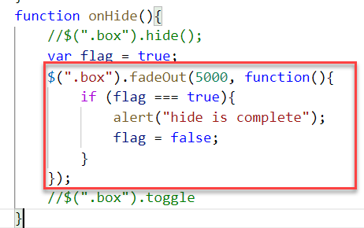
Syntax of jQuery
The jQuery syntax is tailor-made for selecting HTML elements and performing some action on the element(s).
Basic syntax is:
$(selector).action()
$ sign indicated to the browser that we want to use jQuery.
selector: selector is same what we have seen in CSS i.e., #id, .class, tagName
Action(): It is a JavaScript Event or Action which we want to perform on the selected element.
Example:
$("p").hide() - hides all <p> elements.
$(".test").hide() - hides all elements with class="test".
$("#test").hide() - hides the element with id="test".

Slide 6
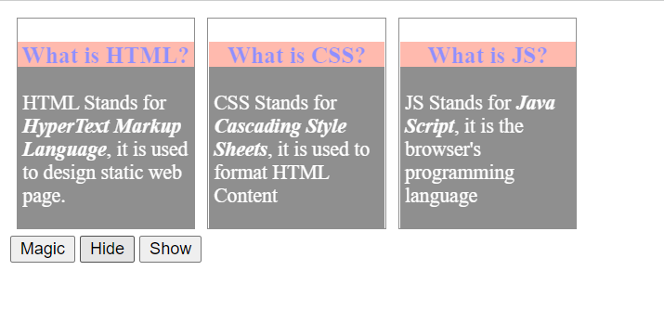
Hands – on: Adding effects using jQuery
Create a new file named jQBasic.html in the Basics folder which we have used for html, css and JavaScript.
Bring the code related to the box and box-content form the previous example.
Now we will add some effects to these boxes using the jQuery actions.
Code Link:
jQBasics.html

Slide 7
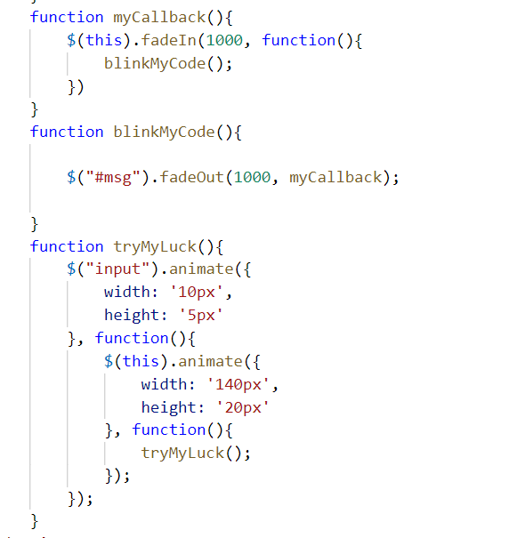
Hands – on: Adding Animation
Now we will add some animations to our html page using the jQuery.
For this we have to bring back the login fields code back form the previous examples.
Code Link:
jQBasics.html

Slide 8

Introduction to UI5
SAPUI5 (SAP user interface for HTML5) or Open UI5 is a collection of libraries that you can use to build desktop and mobile applications that run in a browser. With the SAPUI5 JavaScript toolkit, you can create web applications using HTML5 web development standards.
SAP UI5 is a framework which is used to develop Responsive web applications to run on any platform, any browser and any OS.
Framework: - A framework is a platform for developing software applications. It provides a foundation on which software developers can build programs for a specific platform.
A framework consists of libraries that can be used to process input, manage hardware devices, and interact with system software.
Library: - A collection of Classes.
Classes: - Collection of methods, Attributes, Events.
Your Code
You call the library
Framework call you
Libraries
Framework
Contains

Slide 9

Responsive Web Design
Responsive web design (RWD) is a web development approach that creates dynamic changes to the appearance of a web application, depending on the screen size and orientation of the device being used to view it.
Responsive Web Design is about using HTML and CSS to automatically resize, hide, shrink, or enlarge a website to make it look good on all devices (desktops, tablets, and phones).
Now a days, all the frameworks are designed to adapt the UI according to the screen size of the device.

Slide 10
Structure of UI5 Framework
The UI5 framework is built on top of open standards like HTML5, CSS, JS, and jQuery. UI5 Framework composed of two major components.
1.Design Time Components: It helps us to designing a new application from scratch , it consists of lots of libraries which help to design our application.
2. Runtime Components: It consists of the renderer which is helpful for the conversion of ui5 code into the browser friendly code(HTML+CSS+JS)
The Browser only Understand the HTML , CSS , JavaScript.
BAS or VS Code
App
Creating a App
Using the Libraries
The Runtime component converts the code of application to
SAP UI5 Design Time Component
SAPUI5 Runtime Component
HTML+CSS+JS
sap.m
sap.ui.comp
sap.ui.table
sap.ui.layout
Renderer
sap.ui.core
sap.ui.unified
sap.ui.core.mvc
The browser will now understand the code.
HTML5
CSS
JS
jQuery
Browser

Slide 11
MVC Architecture
MVC Stands for Model , View and Controller.
MVC is a design pattern used in software industries to build applications.
1. Model: It holds the data of the application inside itself.
2. View: It is the output and input interface of the application or can say it is the user interface .
3. Controller : It has all the processing logic inside itself (all written in JavaScript).
The Controller has a event handler to handle the triggered event
eventHandler()
Controller
[Processing]
All processing logic is written in JavaScript because browser only understand JavaScript.
Model will notify the controller back again with the data.
If the event need the data it request the model for the data
The View Triggers a event to the controller.
<<Event>>
The controller get the data and notifies the view back
If we want direct interaction between view and model we use data binding
Model
[Data]
View
I/O
Data Binding
User

Slide 12
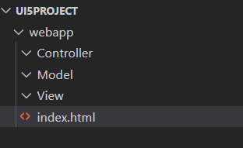
Project Structure of UI5 Project
When you create a new SAPUI5 application, you will be able to see a folder structure created in your project explorer like below.
In a SAP project there are a number of folders and files that you will not recognize if you are not familiar with MVC. Let's have a quick overview.
Within a given project inside the webapp folder , you have three core folders
Model
View
Controller
webapp folder : webapp folder is the root folder of the application in which all the core folders and files of the application were kept.

Slide 13
Create JSON Data
var data = [{}, {}, {}];
Create JSONModel
use sap.ui.model.json.JSONModel ( import it controller)
add them in defines list
create model using new JSONModel()
Set Data to JSONModel
jsonModel.setData();
SetModel to View
this.getView().setModel(jsonModel)
Apply Binding in View
{/} -> Root of the Data / context of the Data
{mappingNames}
Properties
Aggregations
Events :
Register the event with eventname=“functionName”
Define the function in controller
Methods

Slide 14
First UI5 Project in VS Code
Pre-requisites:
We must have node.js v14 or above installed in our system.
We must have sap ui5 tooling installed in our system
npm install –g @ui5/cli (ui5 command line tool)
npm install –g @sap/ux-ui5 tooling (Fiori command tools)
Both are pre-installed in BAS (Business Application Studio)
App creation:-
Initialize a UI5 project , Create a Folder for your project (UI5project) .
We need to create a webapp folder inside our project folder.
inside webapp folder create a manifest.json file
inside manifest.json file create “sap.app”
{
“sap.app”:{
“id”: “mickey”
} }
Now Initialize a node project , In the project terminal run command npm init (auto generate a package.json file).
Now run ui5 init command inside the terminal (ui5.yaml file will generated automatically)
Id is the identifier of the project.
You can give any name as a pet name of the webapp folder

Slide 15
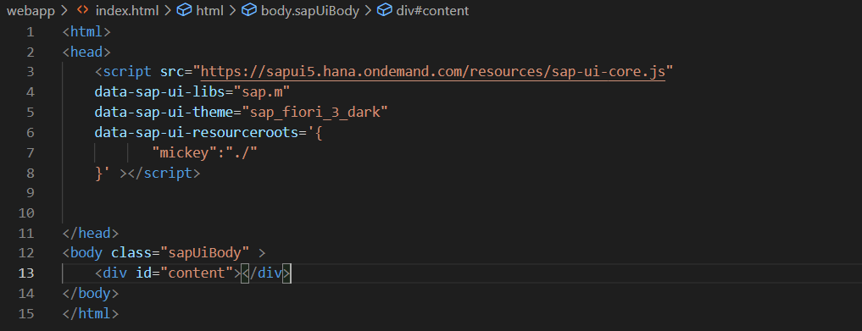
First App Continues……
App-Code:-
Create index.html , load the sapui5 framework from CDN and specify the properties like library and theme
Inside the terminal run command fiori run --open index.html to run your application on the browser.
This is also know asUI5 Bootstrap Code used to initialize the UI5 Framework initially
Here we have to also mention the namespace of the application

Slide 16
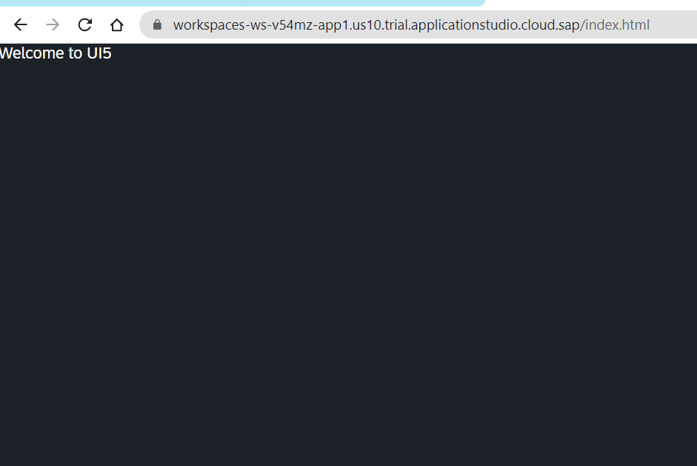
Hands on – Initialize first UI5 Project
Initialize a new ui5 project using the steps mentioned in the previous slide.
Code Link:-
index.html
manifest.json

Slide 17
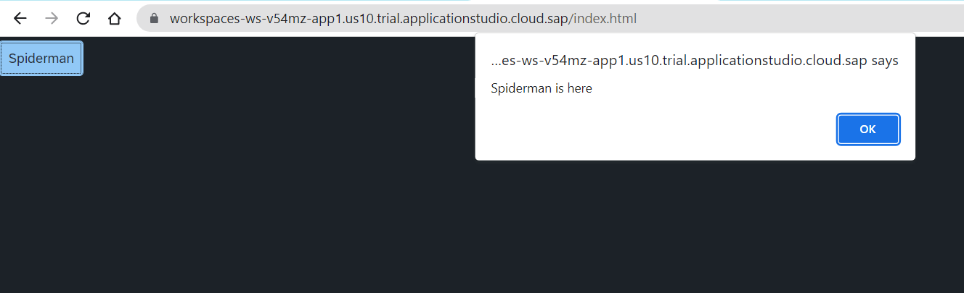
Hands – on: Create a Simple Button Control
Now we will add a simple button control to our app an on press of that button a alert message will be shown to the user, with message “Spiderman is here”.
Code Link:-
index.html

Slide 18
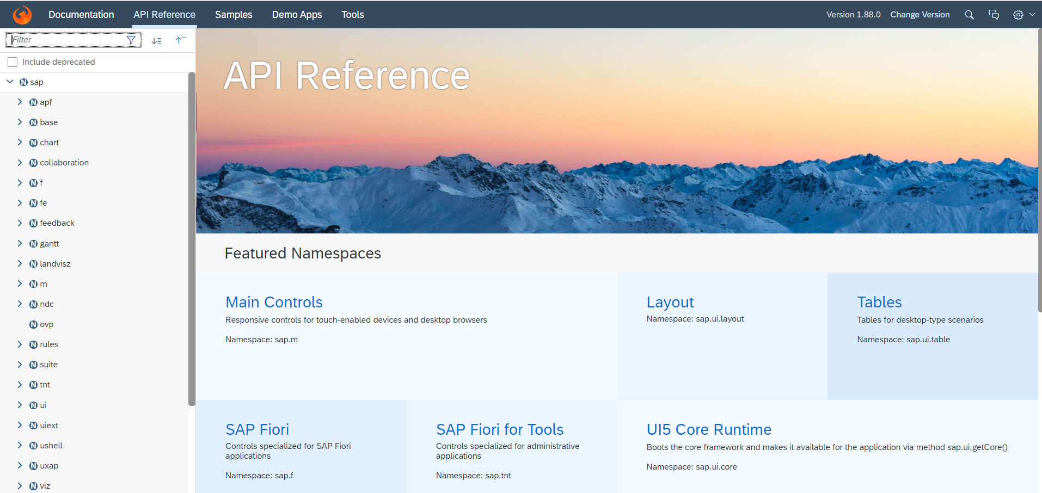
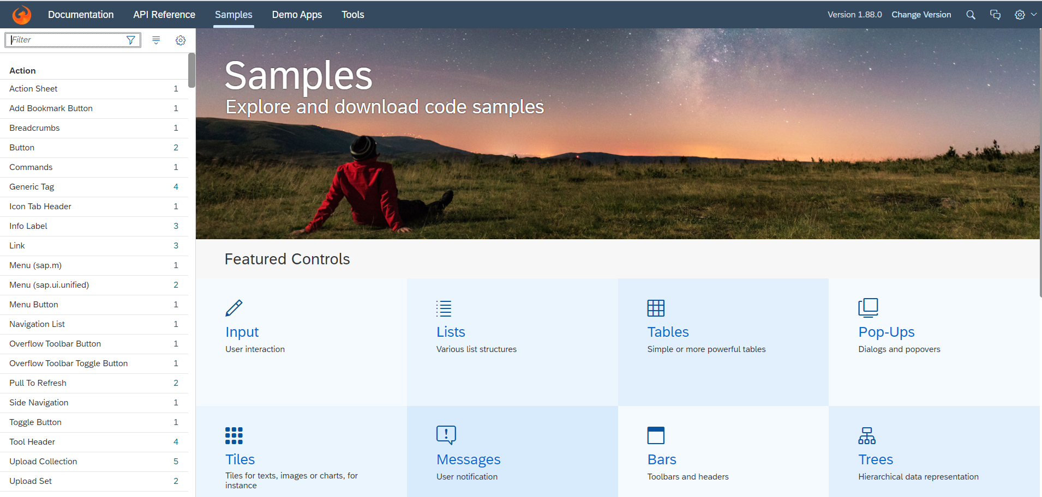
Introduction to UI5 SDK
Documentation of SAP UI5 is available at the SAPUI5 Software Development Kit.
We can access the SAP UI5 API’s at the Documentation page of SAP UI5 or you can use the link to go to sap’s API screen - https://sapui5.hana.ondemand.com/#/api
We can directly search the required api’s on the SDK.
SDK contains the sample of all the controls which we can use in UI5
SAP UI5 API reference screen
SAP UI5 Sample reference screen

Slide 19
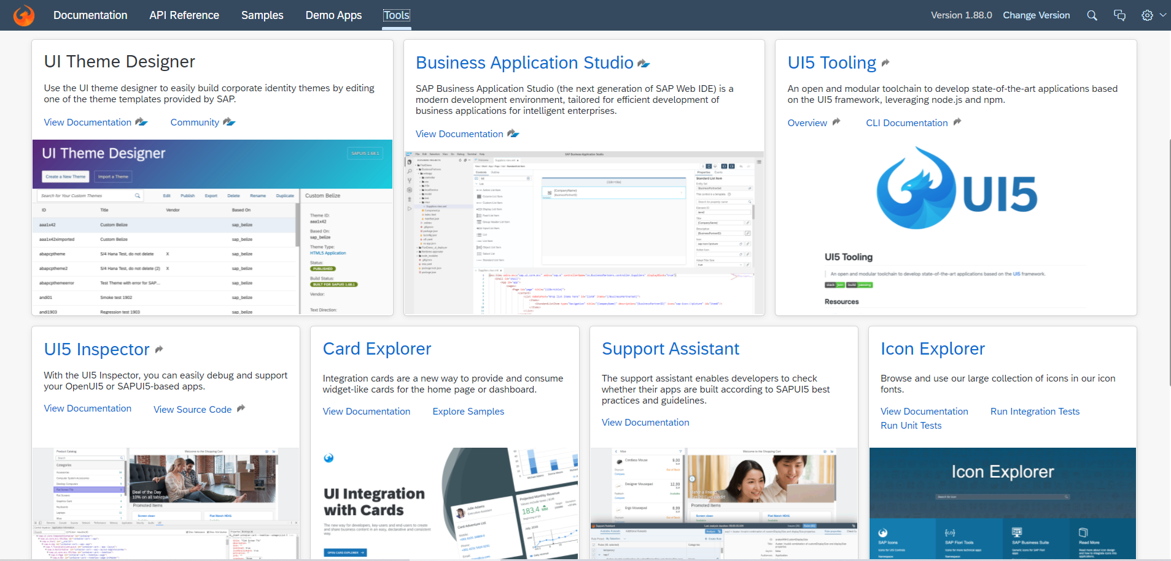
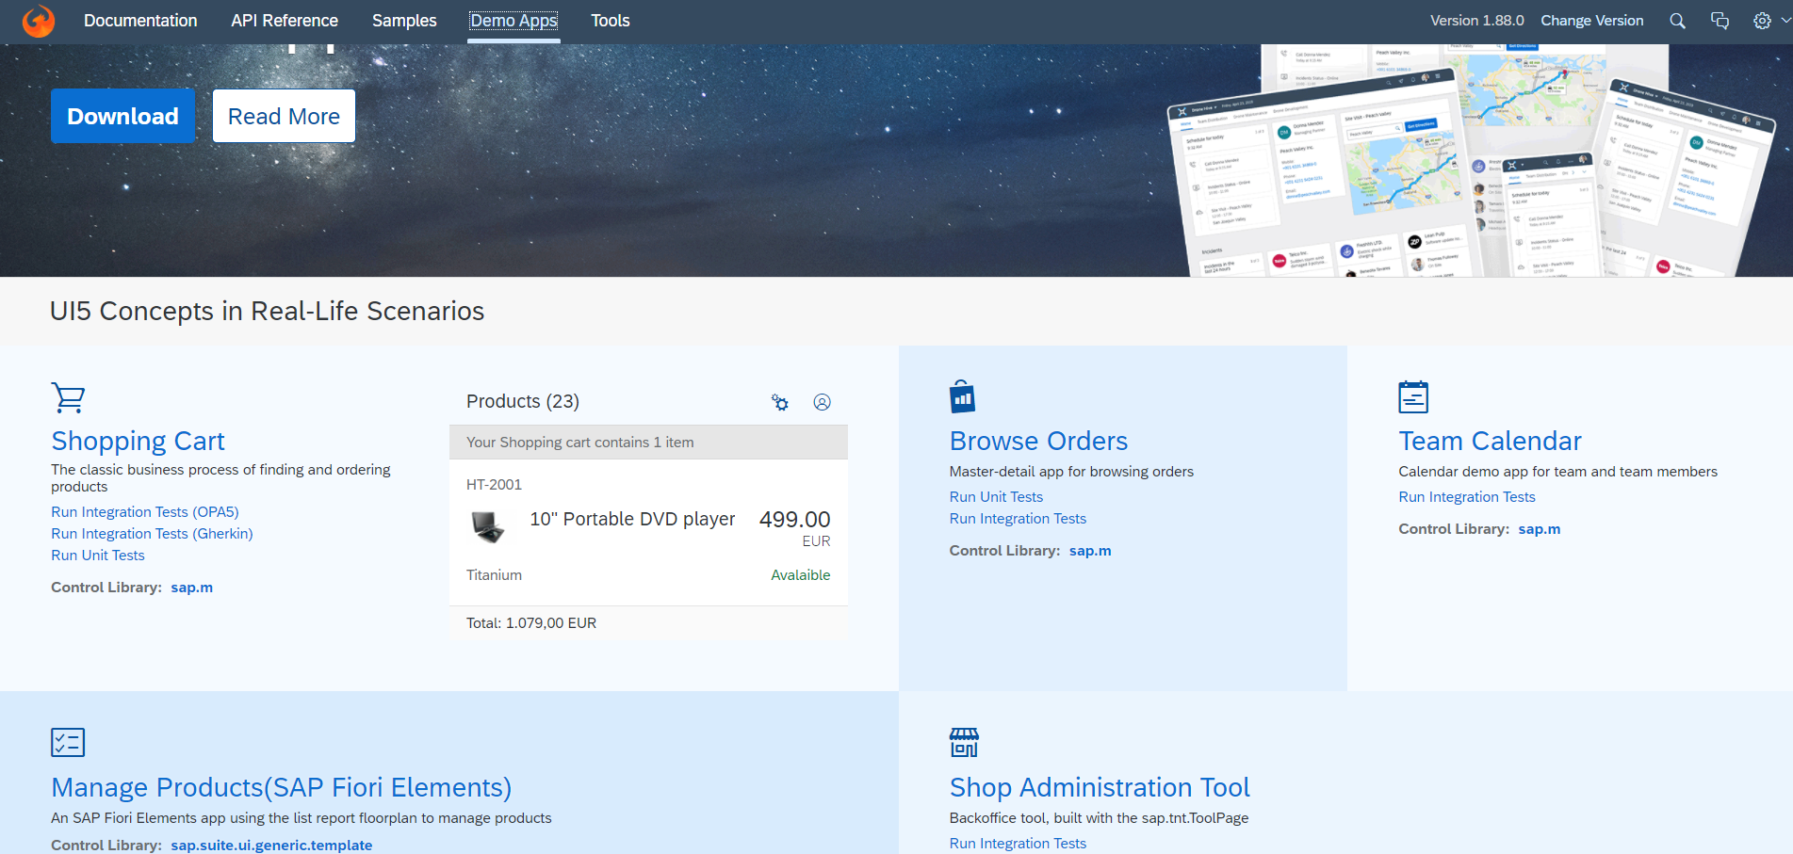
UI5 SDK continues…
UI5 SDK contains tools to make the development smooth for the developers.
It has UI5 icon packs which can be directly accessed for the UI5 SDK’s Tool Screen (Link).
SAP UI5 SDK provides us the demo application, So we can get an idea about how to create different type of applications using UI5 controls
UI5 SDK Tools Screen
UI5 SDK Demo Apps Screen

Slide 20
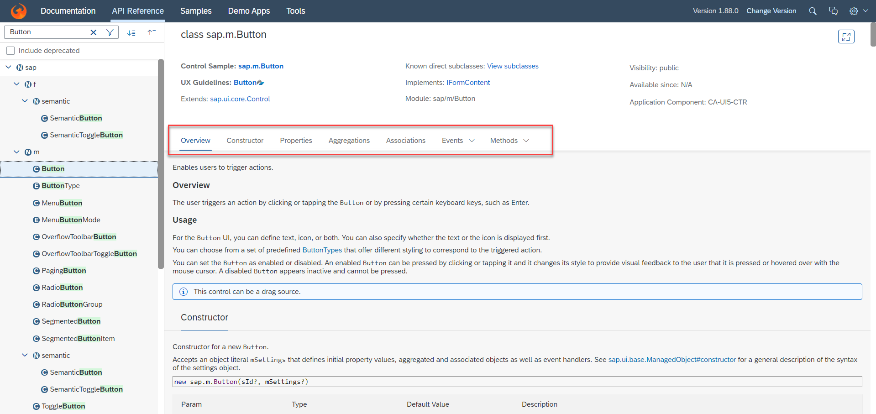
UI5 SDK continues…
When we search and open any API we see a screen similar to one which is shown below.
Every API contains different kind of:
Properties,
Aggregations,
Associations,
Events,
Methods

Slide 21
What is XML
What is XML?
XML stands for eXtensible Markup Language, it was originally developed to move data from one to another technology. It became popular to communicate between heterogeneous technologies.
XML is a tree data structure. Unlike HTML, we can use custom tags. Every programming language must support XML.
Portal
Java
App
ABAP
If_ixml
xml
xml
Data Objects → XML – Rendering
XML → Data Object – Parsing
Why XML View is better than other Views?
It is industry Standard.
XML handles the control id properly
XML rendering is faster
XML properly follows the MVC
Architecture.

Slide 22

Model Basics
Models are object of data. All the models in SAP UI5 are characterized in two different parts:
Client-Side Model: -
Client Side Model are the models which keeps the data in the browser (client side), when app starts all the data will be loaded in one shot to the browser and kept there.
These models are used when the dataset is small and we want to manipulate data locally.
E.g. why we use internal table? – it’s a temporary store to manipulate the data and once we finalize we push data back.
Server-Side Model: -
Server Side Model are the models which keeps the data in the SAP system(server side), when app starts all the data will be loaded in one demand to the browser in a client side model from, server side model.
These models are used when the dataset is large and we want to fetch and store data back to SAP.
Imagine we have 20trillion records in our sap system, we cant access all data at once in mobile fiori app, so we use server side model to load it chunk by chunk.

Slide 23
Steps to Create a Model
There are 4 Easy Steps to Create a Model:
Step 1: Create a brand-new object of the Model
To Create JSON Model - var oModel = new sap.ui.model.json.JSONModel()
To create XML model – var oModel = new sap.ui.model.xml.XMLModel()
To create Resource model – var oModel = new sap.ui.model.resource.ResourceModel()
To create OData Model – var oModel = new sap.ui.model.odata.v2.ODataModel()
Step 2: Set or Load the data in the Model
oModel.setData({});
oModel.loadData(filePath);
Step 3: Make the model aware to the application/view
sap.ui.getCore().setModel(oModel) -- whole city knows where the gold is
this.getView().setModel(oModel) -- only the single view and its child control knows – only my family
this.getView().byId(“controlId”).setModel(oModel) -- one control have access to data – my dad
Step 4: Data Binding : It is the concept of mapping the Views and Model with which the UI knows where the data is into the model. This is done by calculating the path (address of the data).
Create object of the Model
Set/Load Data in Model
Set Model at View Level

Slide 24
Data Binding
Data binding is the process that establishes a connection between the application UI and business logic.
It is a bridge between a binding target(View) and a binding source(Model).
In the json data we can make address as “Every curly braces is converted to / and every array item is converted to /index”.
{"empStr": {
"empId": 0001,
"empName": “Srinivas",
"salary": 8000,
"currency": "USD"
},
"empTab": [{
"empId": 0009,
"empName": “Ananya",
"salary": 9500,
"currency": "USD“
}, {
"empId": 0010,
"empName": “Shwetha",
"salary": 10000,
"currency": “EUR"
}]}
Q: what is the salary of Anubhav
/empStr/salary
Q. What is the emp name of emp 0001
/empStr/empName
Q. What is the salary of Shwetha
/empTab/1/salary
Q. What is the empId of Ananya
/empTab/0/empId
This is the address of the data
To bind the data with the view we have to give the path of the data , so we have to use the curly braces as :
{/empStr/empName}
This is the path of the data

Slide 25
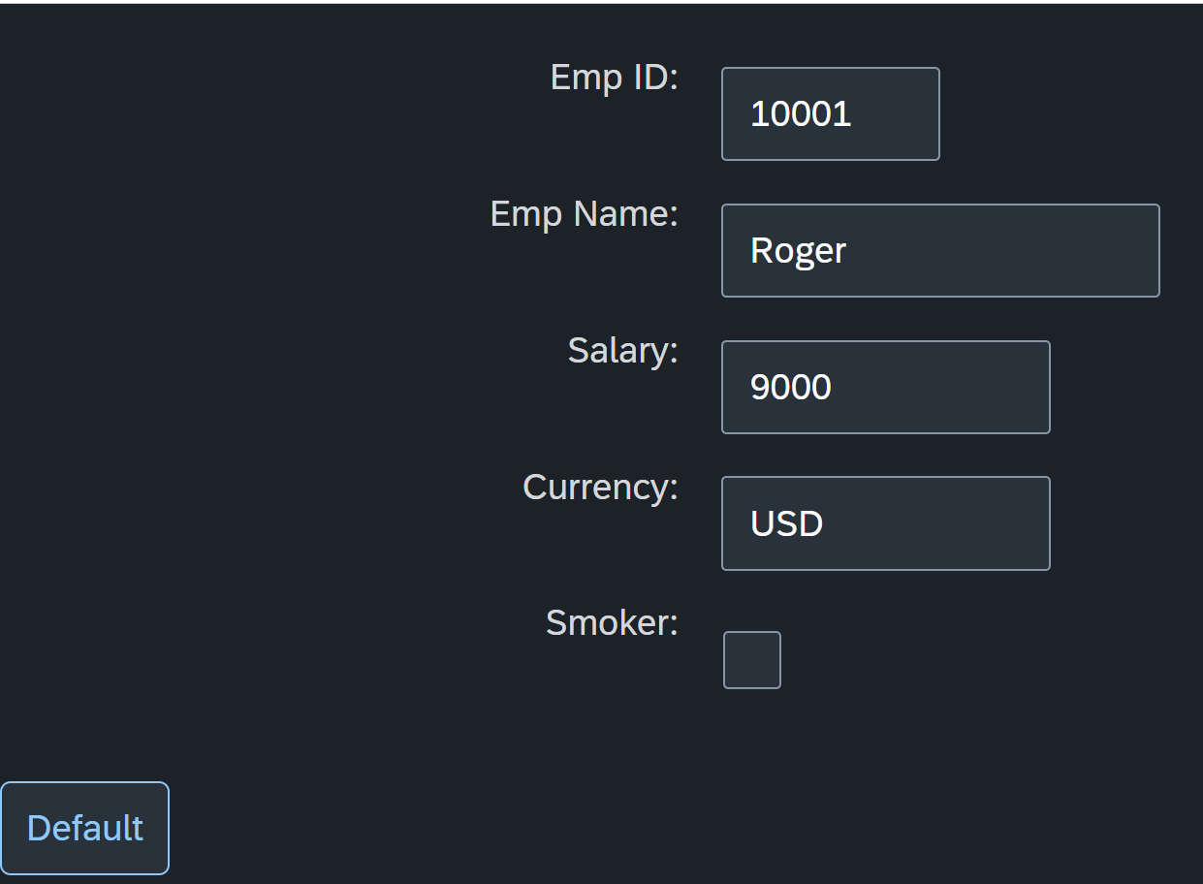
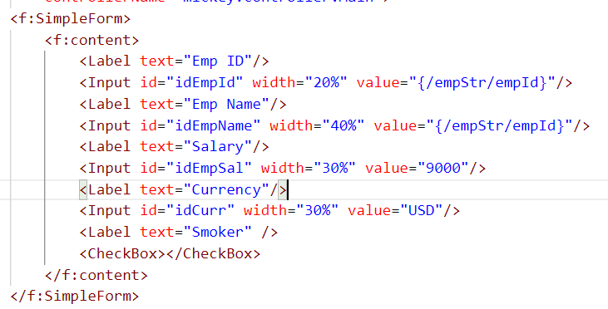
Hands – on: Create our first Model
Create a JSON model by following the steps explained in the previous Slides.
After Creating the Model bind the model to the SimpleForm using different binding Syntaxes.
Code links:-
Main.view.xml
Main.controller.js

Slide 26
Different Methods to Bind Property in View
Binding using the path of the data
{/empStr/empId}
Binding as property specific method:
this.getView().byId(‘controlId’).bindValue(‘/empStr/empSalary’)
Binding as property generic method:
this.getView().byId(‘controlId’).bindProperty(‘value’ , ‘/empStr/empSalary’ )
Binding using the path expression , this is also know as complex binding syntax
{path : ‘/empStr/empId’}
this syntax is helpful when we use formatter .
this syntax will not work by default until we inform it to the SAPUI5, to make this syntax work we have to add a line
code inside the bootstrap code of the application.
data-sap-ui-bindingSyntax= “complex”
Name of the property with which we want to bind

Slide 27
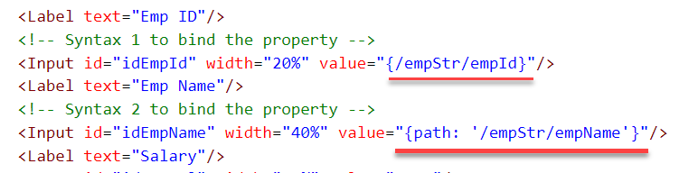
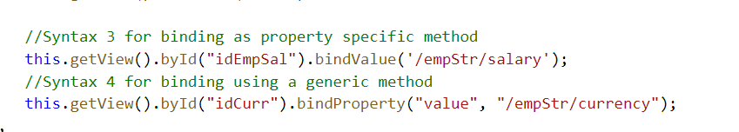
Hands – on: Binding Syntax
Now we will see the different syntax of binding the properties in the View.
Along with that we will see how to align the label and fields in the SimpleForm control.
Code Links:-
Main.view.xml
Main.controller.js
Index.html

Slide 28

Types of Binding
SAP UI5 have 4 types of Binding options:
Property Binding
Expression Binding
Aggregation Binding
Element Binding
Property Binding:-
When we bind property of a UI control, to the address/path of the model, this is called property binding. E.g., value property of Input control was connected to /emp/empId
All the four syntaxes we studied in previous slide are the example of property binding.
Ex:-
In XML view:-
<Text text=“{/emp/empId}” ></Text>
In controller: -
this.getView().byId(“controlId”).bindProperty(“text”, ‘/emp/empId’);

Slide 29
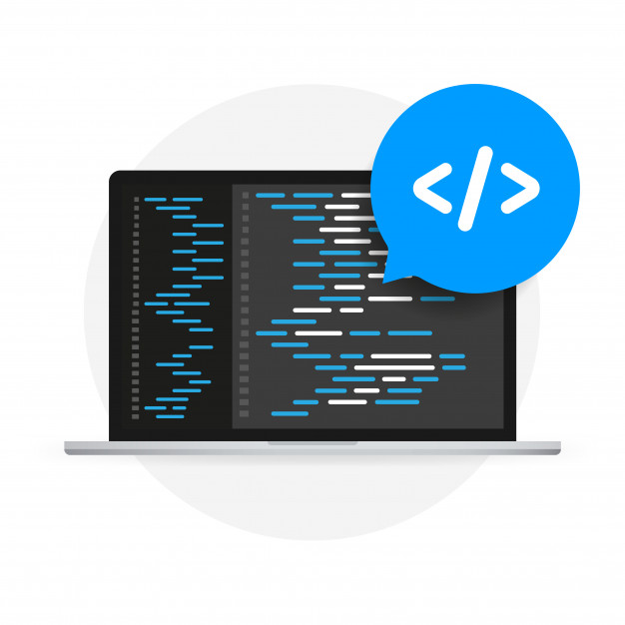
Expression Binding
Expression binding : - When we bind an Expression ({= condition ? true : false}) with the property of a control rather binding value to a property, this is called expression binding.
If we need some calculation on model data or some sort of comparison, then expression binding is useful.
Syntax:
numberState = “{= ${path} > value ? ‘conditionForTrue’ : ‘ConditionForFalse’ }”
Use Case of Expression Binding
My Manager want to add a make salary field grayed(read-only) whenever the employee name is Anubhav.
If The Employee Name is Anubhav, the salary must be 20000.
Condition – if employee name = Anubhav
Outcome – the salary must be 20000
Target – Salary field

Slide 30
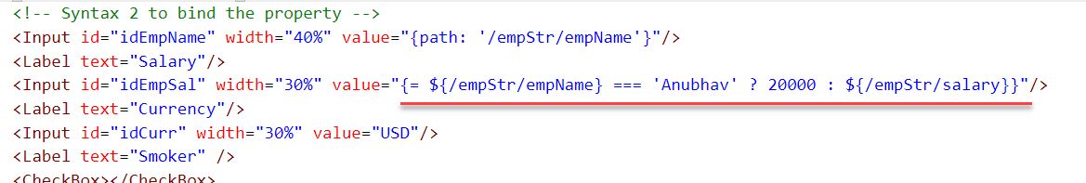
Hands – on: Expression Binding
Now we will bind the Salary field in the SimpleForm with the help of Expression binding Syntax according to the use case mentioned in the previous slide.
Before that we have to comment the line in the controller in which we are binding it form model.
Code Link:-
Main.view.xml
Main.controller.js

Slide 31
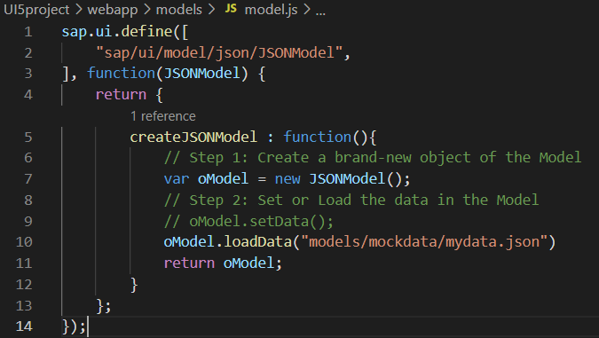
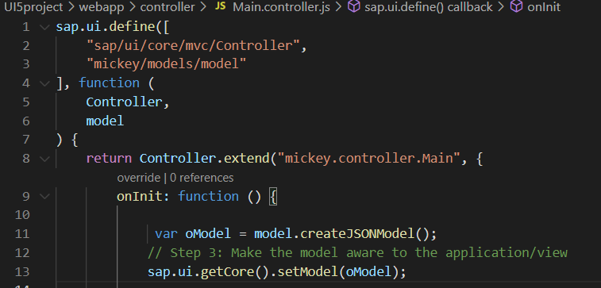
Modularization of Model
1. Create a folder in webapp with name models.
2. Inside models create a file name model.js and then create the function named createJSONModel: function(){}
3. Now create a folder inside the models named mockdata and then inside mockdata create a file named mydata.json
4. Inside the mydata.json put all the data in JSON format.
5. Then inside the models.js :-
6. Then call the model.js inside the controller and create the object then by using the object call the function of model.js
Loading the data from mydata.json using loadData() function
Call the model.js into the controller as dependency.
Object of the model.js
Call the createJSONModel function using the object

Slide 32
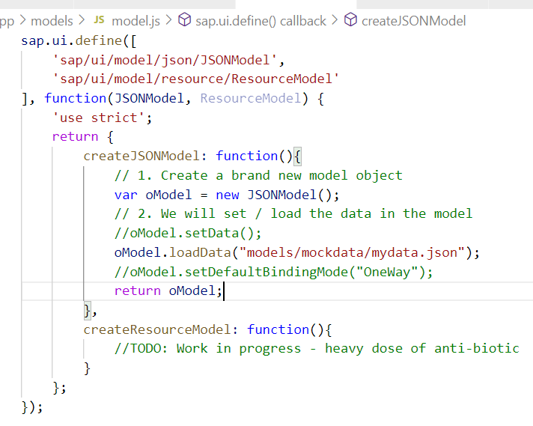
Hands – on: Modularize the Code
Now modularize our model code using the steps shown in the previous slide.
We will also see how to load the data form the model.
Code Links:-
Main.controller.js
model.js
mydata.json

Slide 33
Binding Modes
There are basically three modes of binding data in SAPUI5.
One-way binding – Here, the data is transported in one direction only, i.e., from the model, through the binding instance to the consumer (usually the property of a control), but never in the other direction. Any change done on the model data from the front end is not affected to the model. All the data changes are reflected only on the controls.
Two-way binding – Here all input changes done from front end controls are reflected on the model and the backend database. SAPUI5 automatically handles the transport of data both from the model to the controls and back from the controls to the model. It is the default binding mode.
One-time binding – Here all data will be bound from model to view just once. After that, the connection is no more set.
Data
Data
Model
View
Model
View
Data
One-way binding
Two-way binding
Data
Data
Data
Model
View
Model
View
One-Time binding

Slide 34
Concept of Named Model
Concept of named model comes into observation when we want to use more than one model simultaneously in one application. When we uses two model simultaneously the there are some conflicts arises in the application , as the second model we use will overwrite the data of the first model. So, here we use the Named Model
Creation of Named Model :
this.getView().setModel(oModel2 , “Name of the model”) ;
For example :
this.getView().setModel(oModel2 , “thanos”); → here thanos is the name of the model
Binding using the Named Model:
So in binding we use this name, to bind the data from the named model we use modelName>path in binding syntax
For example:
“{thanos>/empStr/empName}” this will bind the name from thanos model.

Slide 35
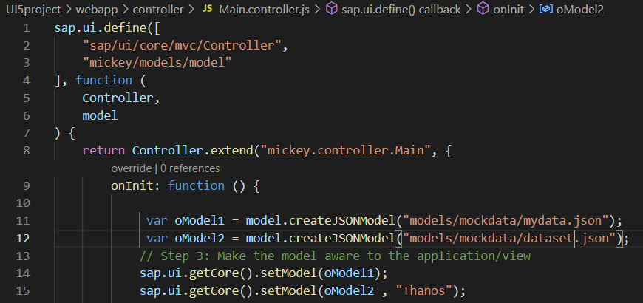
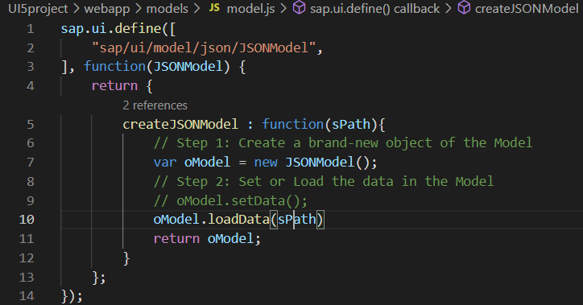
How to create a Named Model
Create a model (dataset.json) in the models folder .
In controller , we have to give the path in the createJSONModel() function
In model.js we have to pass the path as a parameter to create the model with different paths form the same function.
To bind the data in view , we have to use the name of the named model.

Slide 36
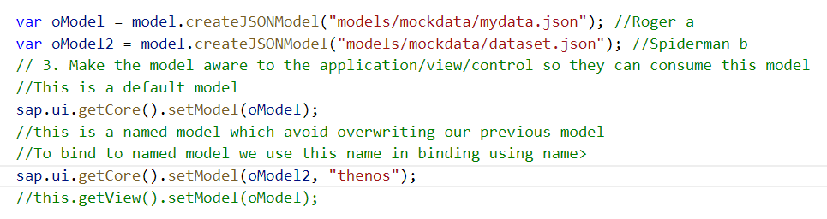
Hands-on : Creation of named model
Now we will see the concept of named model.
Code Links:-
Main.view.xml
Main.controller.js
model.js
dataset.json

Slide 37
Aggregation Binding with Table Control
When we bind the aggregation of a control with the entityset of data model, it is called aggregation Binding.
The parent control (e.g. Table) is bound to the EntitySet path which is called absolute path and the child of the parent Control (e.g. Columns) are connected to the child properties of the EntitySet is called relative path.
In aggregation binding, based on your model data, as many child controls will be created automatically.
Every Event of UI5 will trigger the eventHandler and we will get the Event Object as part of the event Handler. Depending on the event, the event handler object will have different parameters.
Use Case of Aggregation Binding
If we want to show a list or some data in tabular format, we need to bind a group of data. In such a case we will use aggregation binding.
Absolute path
{
“empTab”: [
{
“empId”: 50,
“empName”: “Jay”,
“salary”: 9500
}
]
}
Table = {/empTab}
Emp Id | Emp Name | Salary
{empId} | {empName} | {salary}
Relative Paths

Slide 38
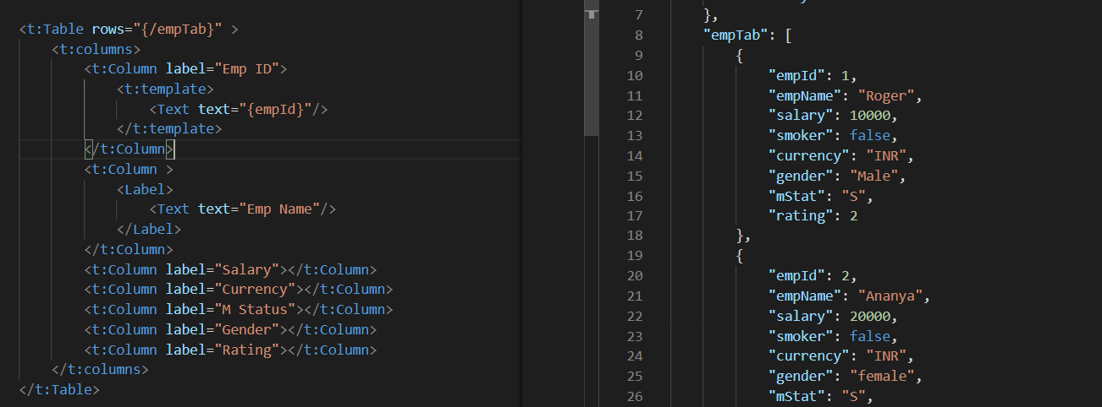
Absolute Path : Connecting parent to parent
Relative Path : connecting child to child respective to parent control

Slide 39
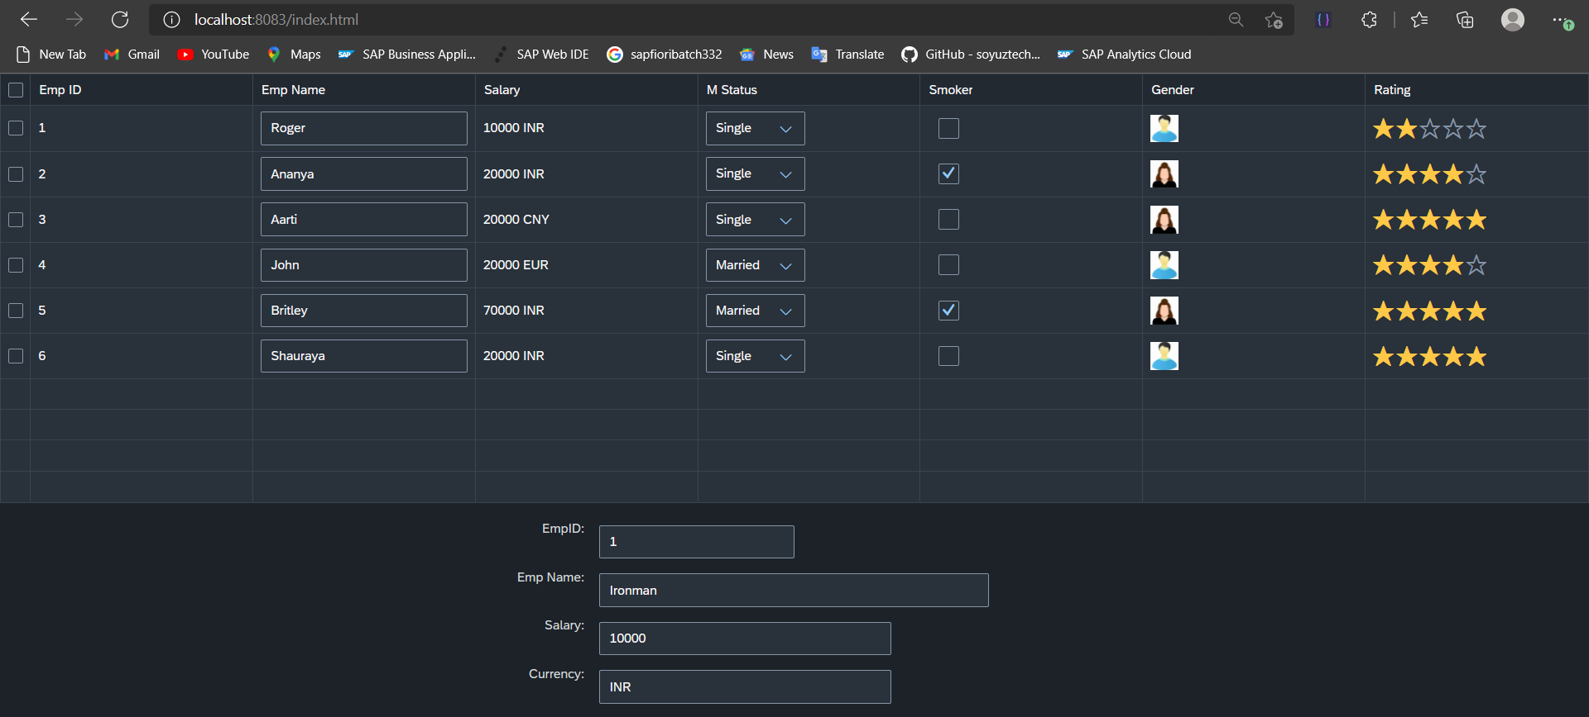
Hands – on: Aggregation Binding & Table
Now we will see how the Aggregation binding works with the help of the table control in SAP UI5.
Documentation of Table control:- https://sapui5.hana.ondemand.com/#/api/sap.ui.table.Table
Code Link:
mydata.json
Main.view.xml

Slide 40
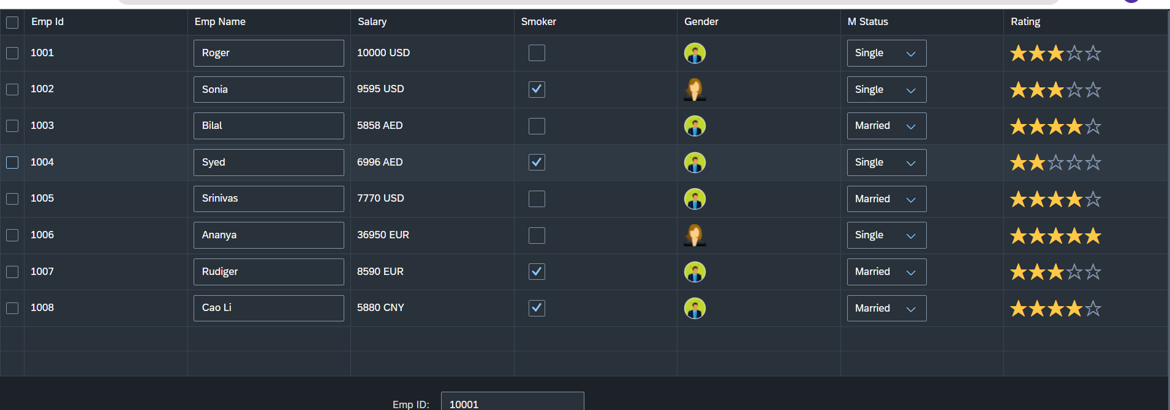
Hands – on: Table with Different Controls
Now we will add different type of controls to the UI table, like Input field, Image, Select, Rating Indicator, Check Box etc.
Code Links:-
Main.view.xml
mydata.json

Slide 41


End of Day 2

Slide 42

Questions

Slide 43

Srinivas

